Slide 1
The Ocean Across Scales Flashcards
For Bring Your Own Water Module, 2018 (answer key)

Slide 2
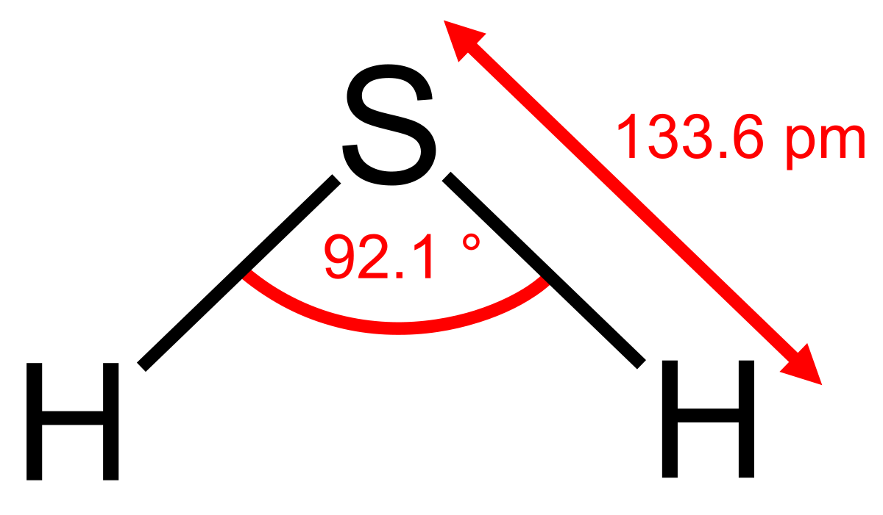
Hydrogen Sulfide

Slide 3
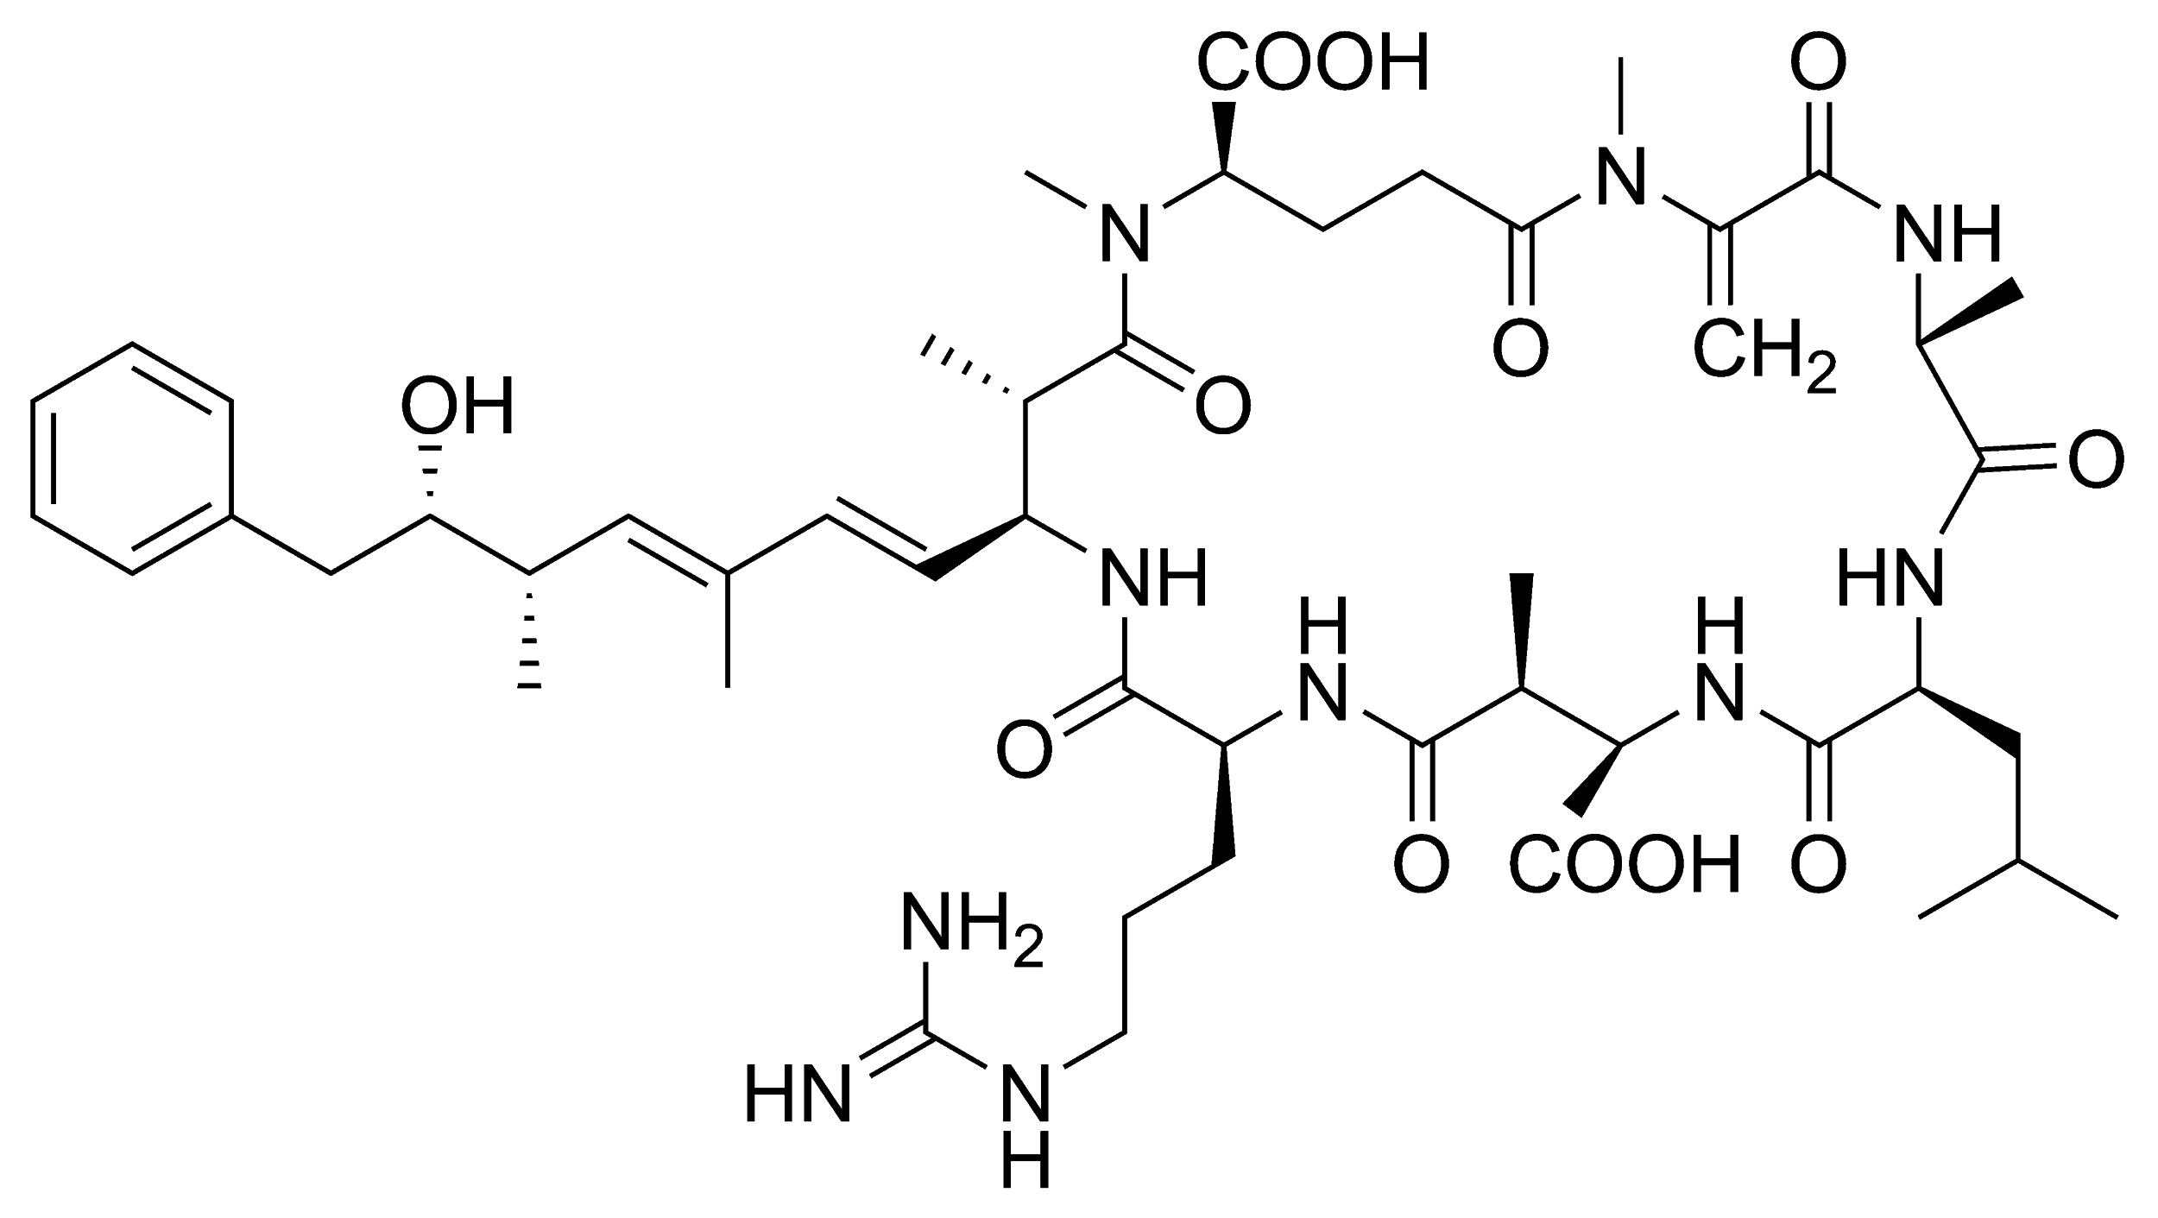
Cyanotoxin

Slide 4
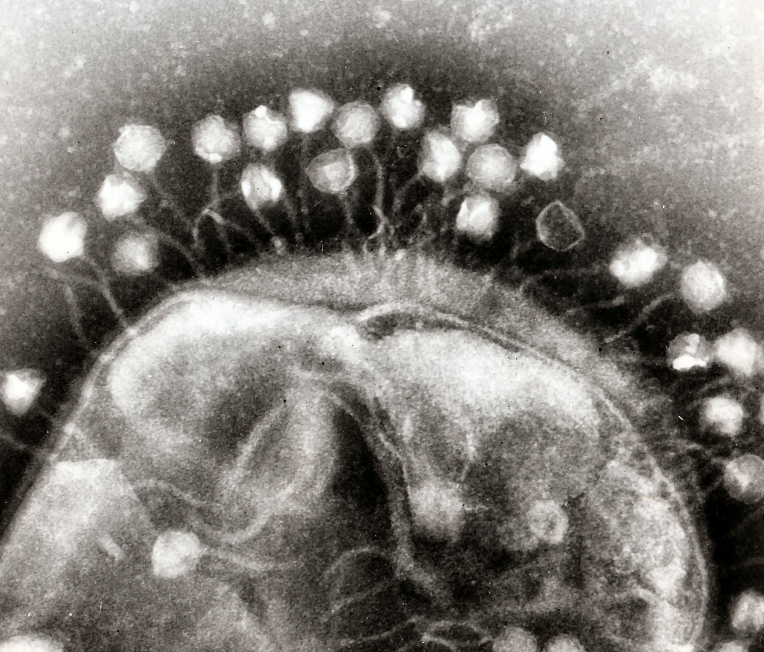
Bacteriophage
Notes:
< 0.2 µm

Slide 5
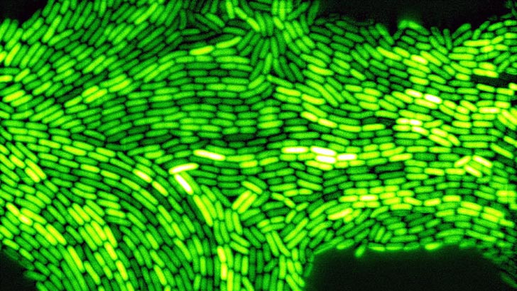
Aliivibrio fischeri
Notes:
0.2→2 µm

Slide 6
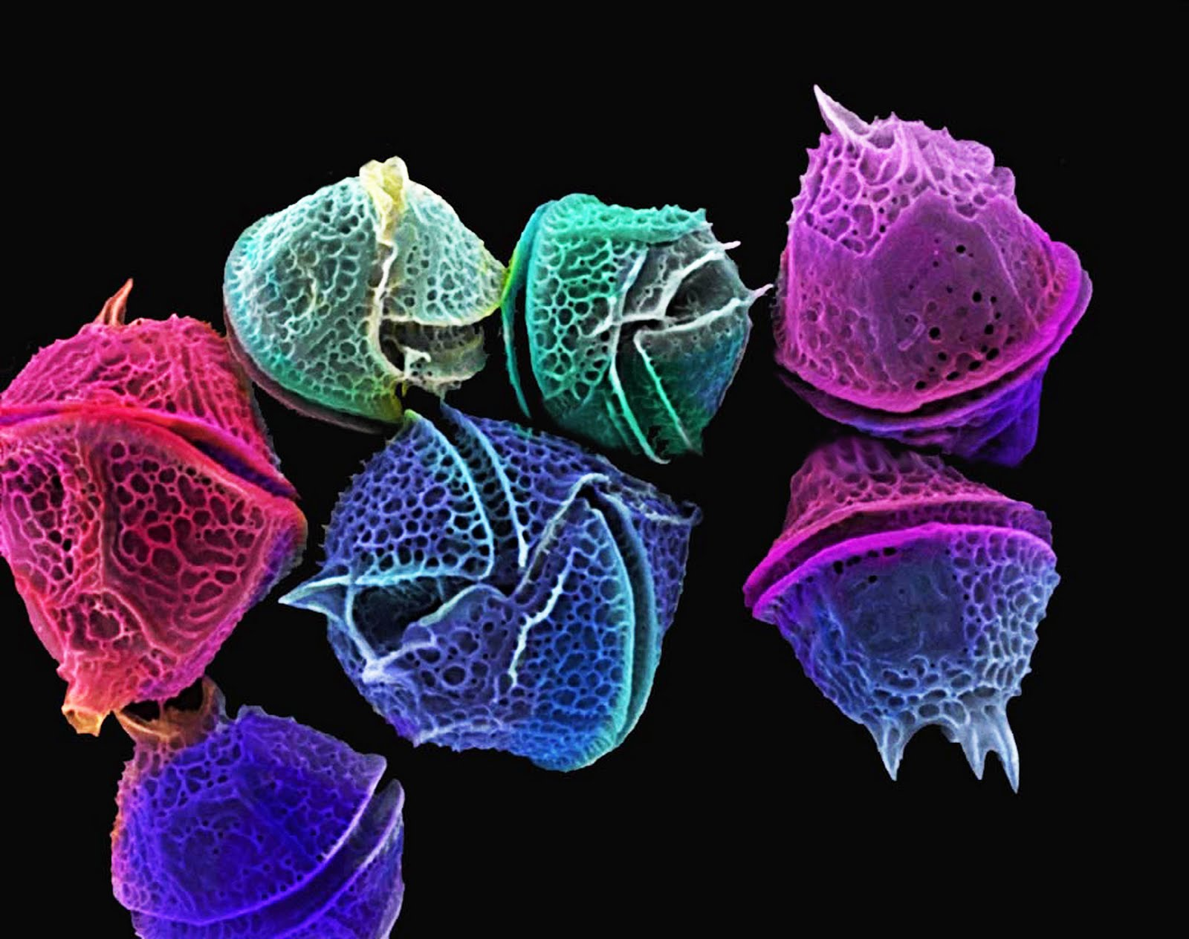
Dinoflagellate
Notes:
2→20 µm

Slide 7
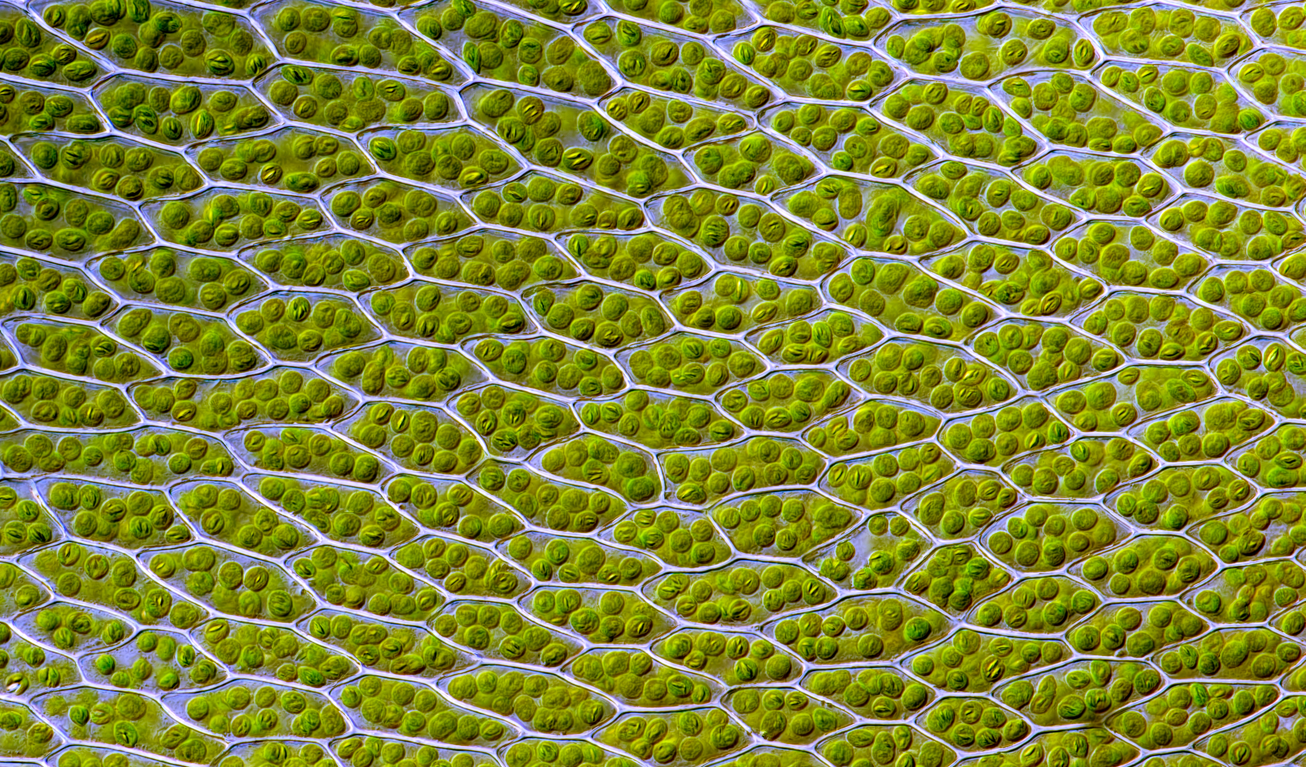
Chloroplast
Notes:
10 to 20 um

Slide 8
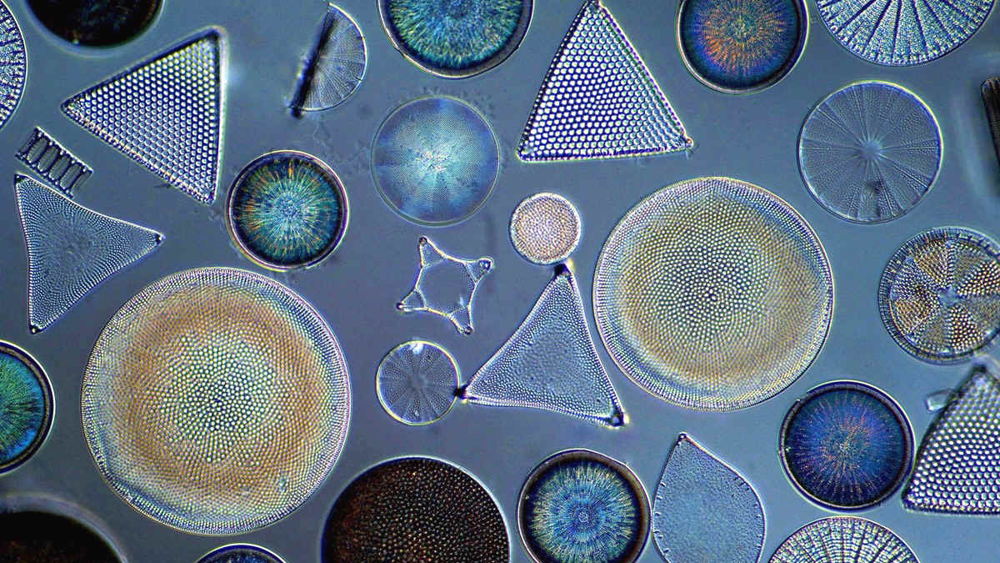
Diatoms (Phytoplankton)
Notes:
20→200 µm

Slide 9
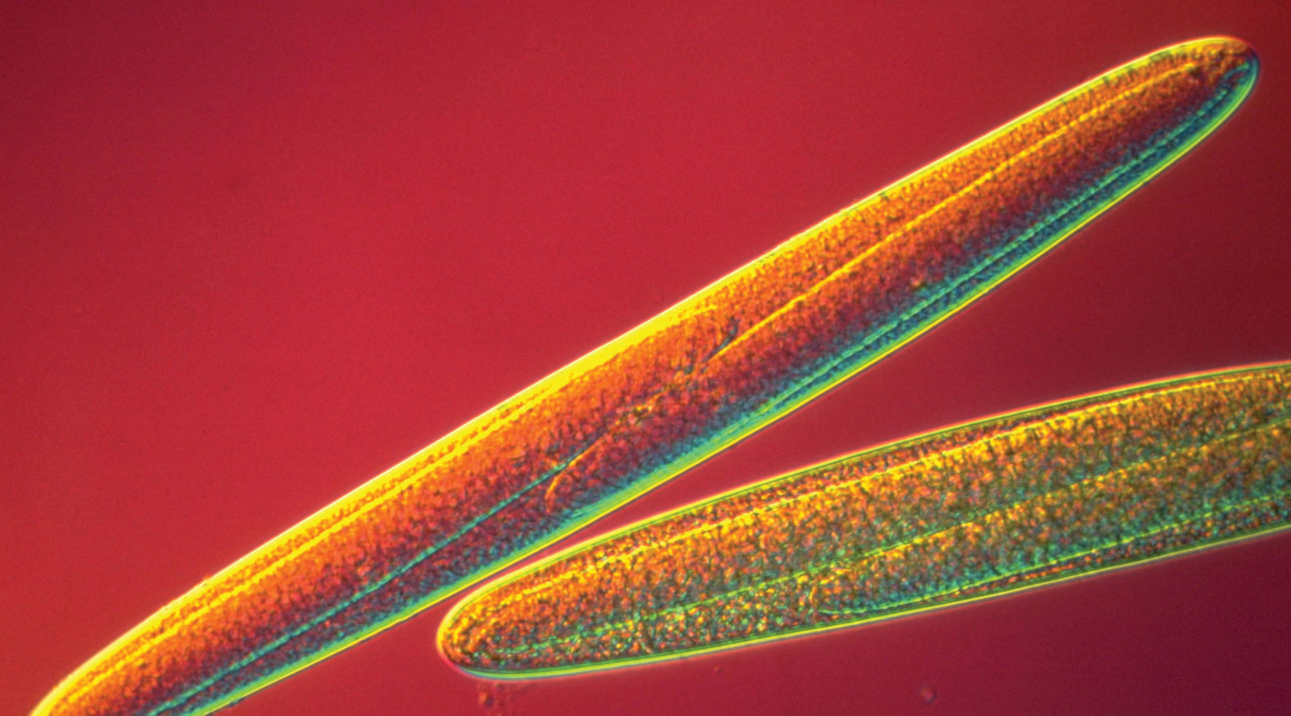
Epulopiscium fishelsoni
Notes:
200–700 μm

Slide 10
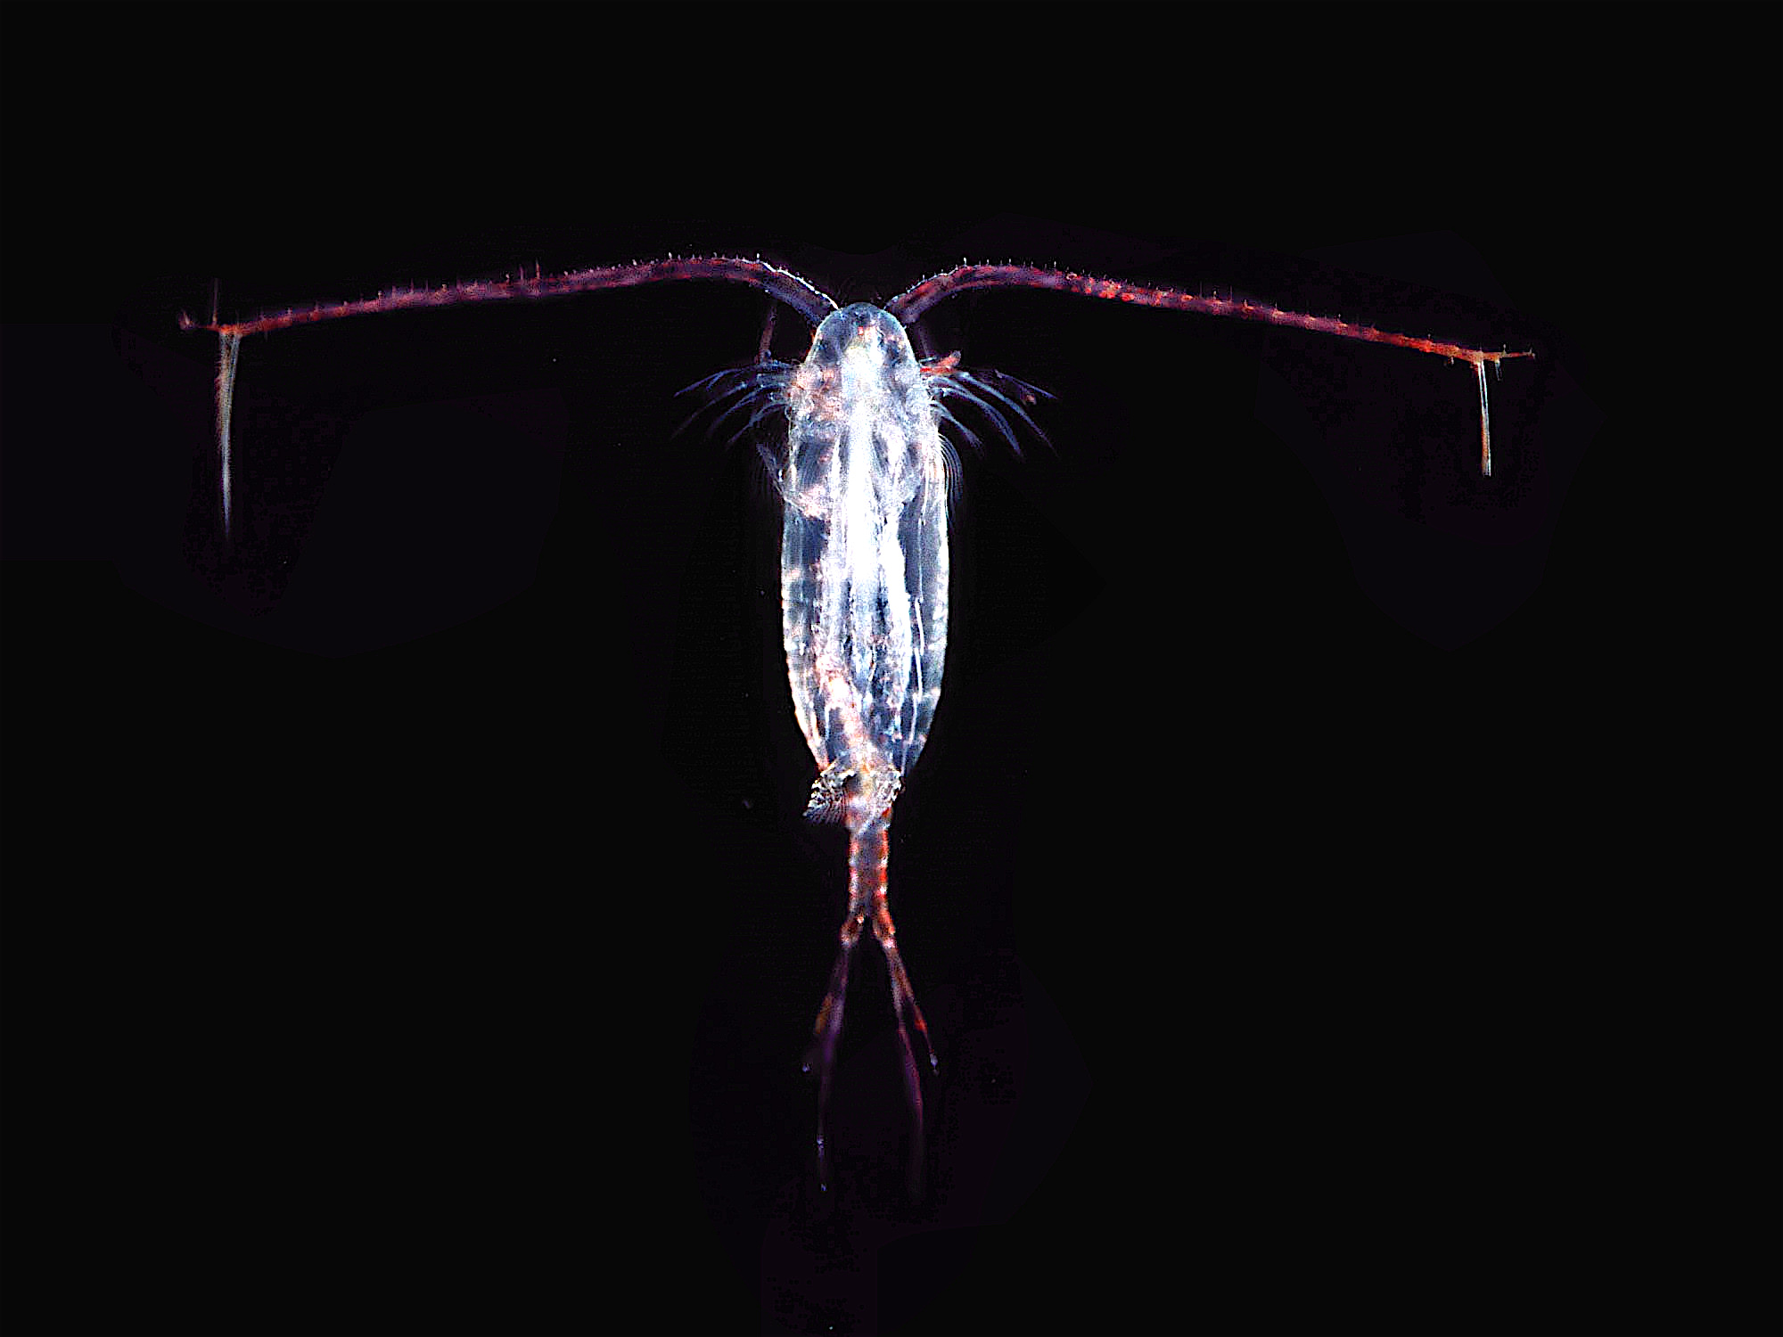
Copepods
Notes:
0.2→20 mm

Slide 11
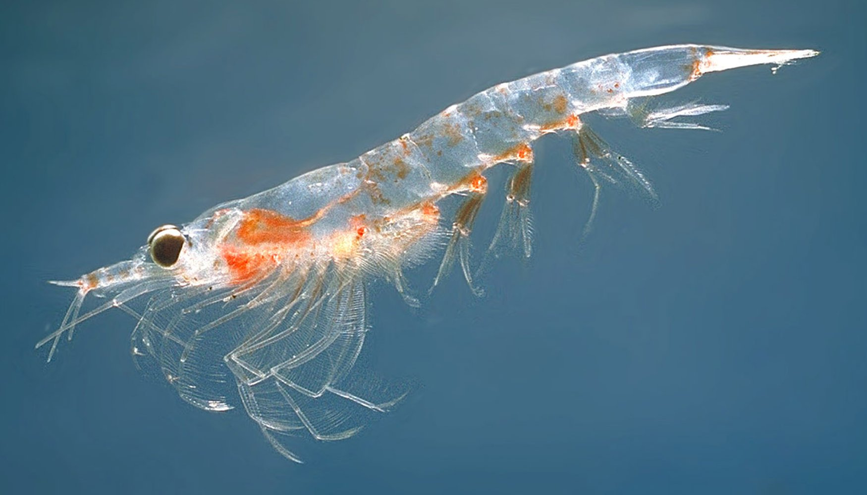
Krill
Notes:
2→20 cm

Slide 12
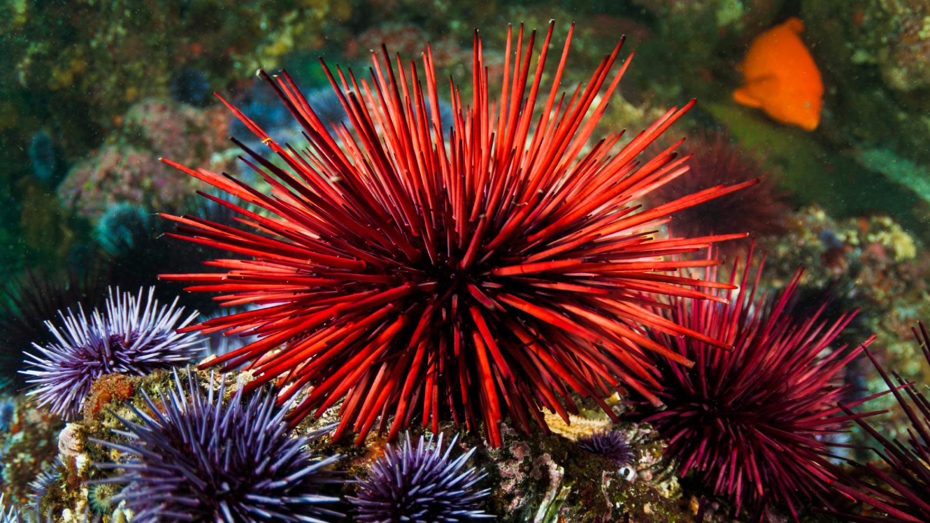
Sea Urchin
Notes:
7.5 in

Slide 13
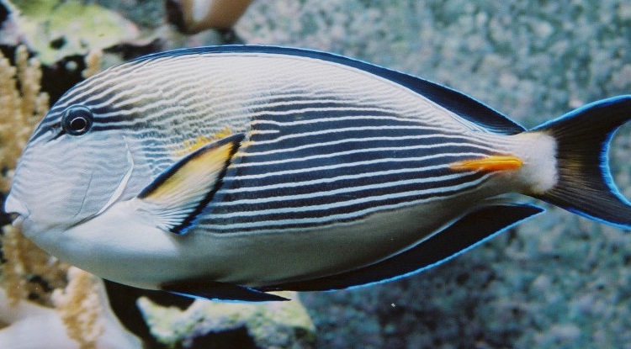
Surgeonfish
Notes:
16 in

Slide 14
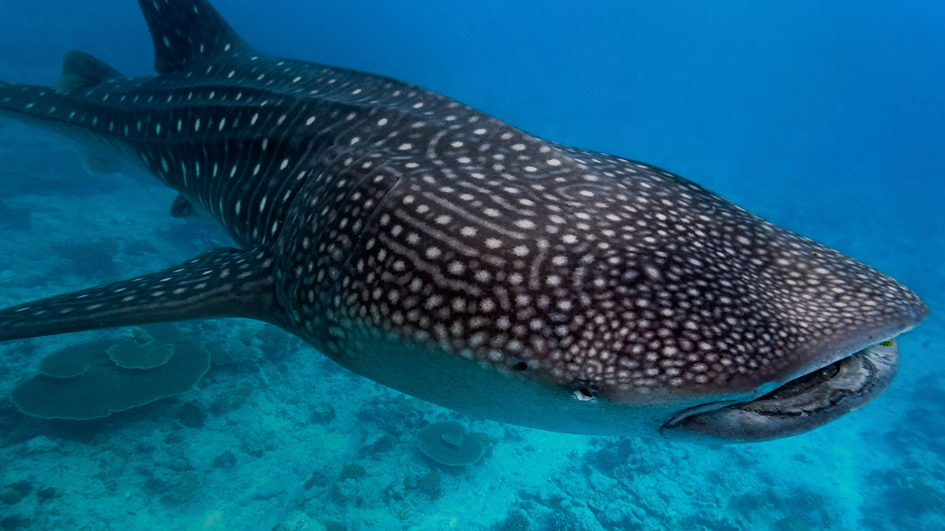
Whale Shark
Notes:
33 ft

Slide 15
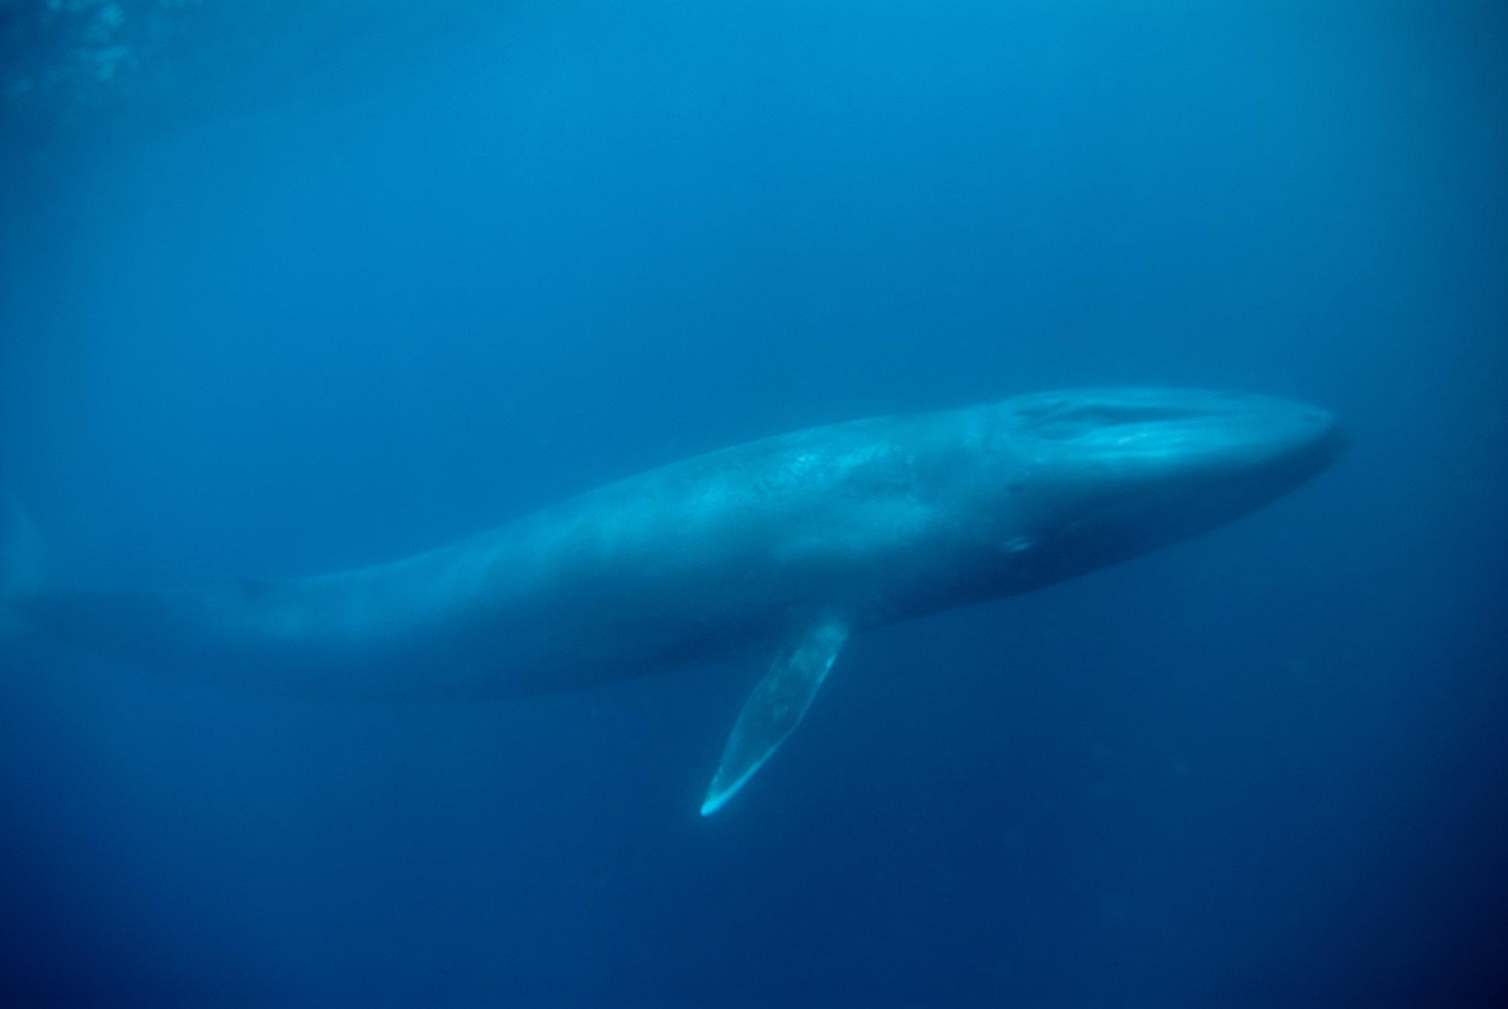
Blue Whale
Notes:
82 ft.

